Slide 1

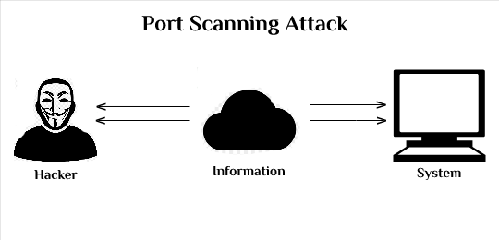
NETWORK PORT SCANNER
USING PYTHON AND BASH
Submitted in the partial fulfillment for the award of the degree of
BACHELOR OF ENGINEERING
IN
COMPUTER SCIENCE ENGINEERING Hons. INFORMATION SECURITY
Submitted by:
SUBHAM CHATERJEE
21BCS8319
TANIK CHOPRA
21BCS6965
Under the Supervision of:
Ms. RAVNEET KAUR
Department of AIT-CSE
DISCOVER . LEARN . EMPOWER

Slide 2

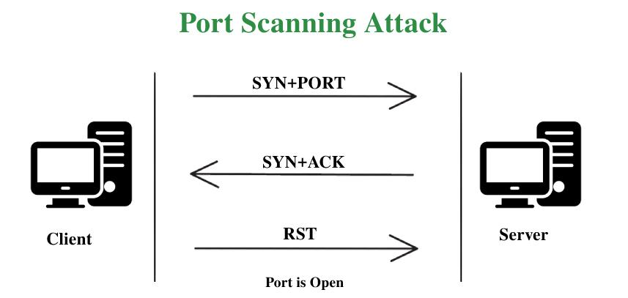

Outline
Introduction to Project
Problem Formulation
Objectives of the work
Methodology used
Characteristics Identification
Constraints Identification
Analysis of features and finalization subject to constraints
Design Selection
Conclusion
Future Scope
References

Slide 3
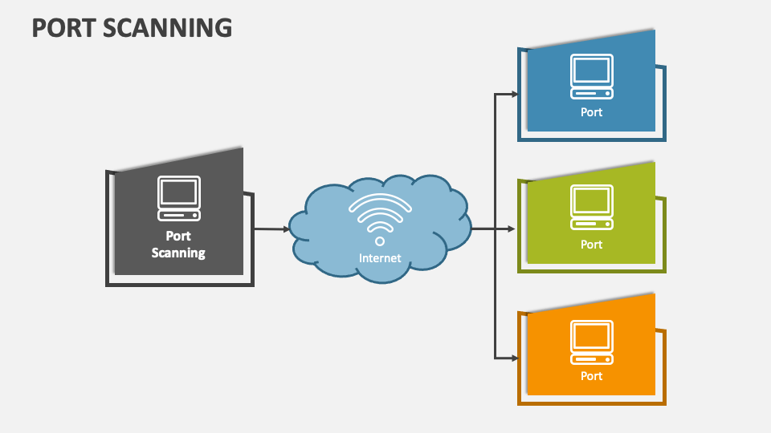
Introduction to Project
The network port scanner project aims to help network administrators and security professionals assess network security by detecting open and closed ports on target systems. The project involves crafting a network port scanning tool using Python and Bash scripting. The following are the key points to consider:
In today's interconnected world, network security is a top priority due to the reliance on digital communication and data exchange.
The network port scanner project plays a crucial role in this context by focusing on evaluating network security through the identification of open and closed ports on specific target systems.
This initiative aims to develop an advanced network port scanning tool, employing the combined capabilities of Python and Bash scripting.
By creating this tool, the project endeavors to empower network administrators and security experts with an efficient means of pinpointing potential vulnerabilities within networks.

Slide 4
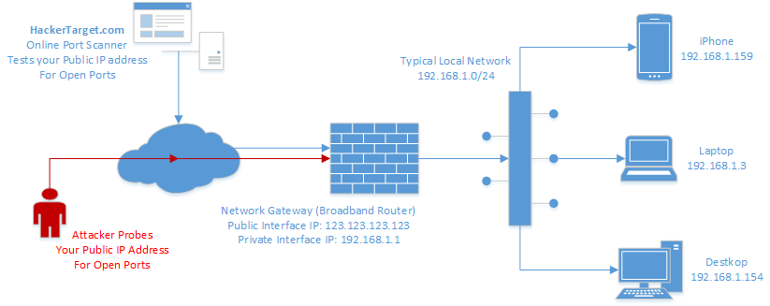
Problem Formulation
Network Vulnerabilities: In the ever-evolving digital realm, networks are susceptible to a range of security vulnerabilities, stemming from misconfigurations, outdated protocols, or unauthorized access attempts.
Time-Consuming Manual Scans: Traditional methods of manually scanning network ports are time-consuming and impractical for larger networks, leading to delays in identifying potential vulnerabilities.
Efficiency and Accuracy: There's a pressing need for an automated solution that not only expedites the process of scanning ports but also enhances the accuracy of results, minimizing the potential for oversight.

Slide 5

Objectives of the Work
The main objectives of this project is as follows:
Develop a sophisticated network port scanner by utilizing the capabilities of Python and Bash scripting.
Create an easy-to-use command-line interface that enables users to configure and initiate scans effortlessly.
Implement multiple scan types, including TCP Connect, SYN, and UDP scans, to ensure comprehensive coverage of potential vulnerabilities.
Provide well-structured and concise results that clearly indicate open and closed ports on the targeted system.

Slide 6



Methodology used
Requirements Analysis:
Identify necessary features and scan types.
Define user interface specifications.
Development:
Script scan types in Python (TCP, SYN, UDP).
Create user-friendly Bash interface.
Testing and Optimization:
Rigorously test tool across scenarios.
Optimize Python scripts for efficiency.

Slide 7
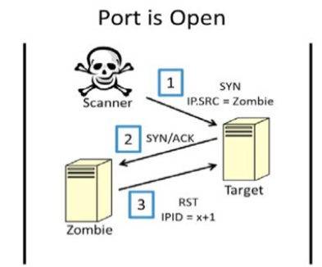
Characteristics Identification:
Scan specific ports or port ranges
Identify open ports and services
Save and load scan results
Support for different operating systems

Slide 8
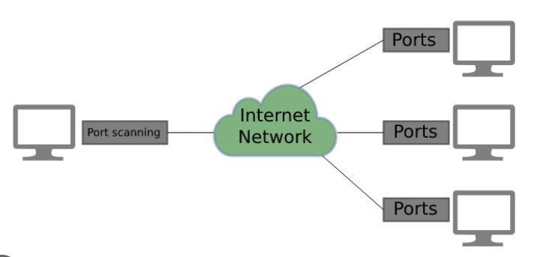
Constraints Identification
Use a specific library : Used re, nmap, request, tkinter library
Support specific operating systems: Supports Linux command line interface , Windows graphical user interface.
Use a specific programming language: Python and Bash

Slide 9
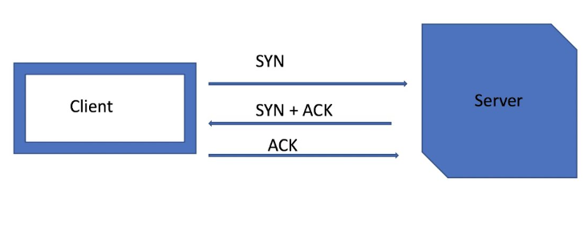
Analysis of features and finalization subject to constraints
Identify the essential features.
Analyze the constraints.
Prioritize the features.
Finalize the feature set.
Implement and test the features.

Slide 10
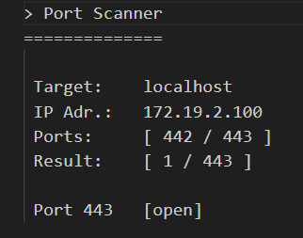
Design Selection
Versatility and Power: Chose Bash and Python for their complementary strengths.
Efficiency and Resource Optimization: Selected to minimize resource consumption.
Cross-Platform Compatibility: Ensures the tool can run on various operating systems.
User-Friendly Customization: Python's readability allows for user-friendly customization.

Slide 11

Conclusion
Enhanced Security Assessment: The network port scanner project successfully addresses the challenge of identifying potential vulnerabilities by automating the port scanning process.
Efficient Vulnerability Detection: The tool's Python and Bash scripting synergy results in a reliable and efficient scanner, saving time and minimizing errors.
Immediate Actionability: Real-time results enable prompt security responses, bolstering network defense.
Contributing to Cybersecurity: The project aligns with the broader mission of enhancing network security and safeguarding digital assets.

Slide 12

Future Scope
Service Version Detection: Extend the tool to identify service versions on open ports, aiding in vulnerability assessment.
Integration with Security Databases: Incorporate databases of known vulnerabilities to enhance utility for security professionals.
Graphical User Interface (GUI): Develop a GUI version for users preferring visual interaction.
Network Mapping: Integrate network mapping to visualize topology and pinpoint potential attack vectors.

Slide 13
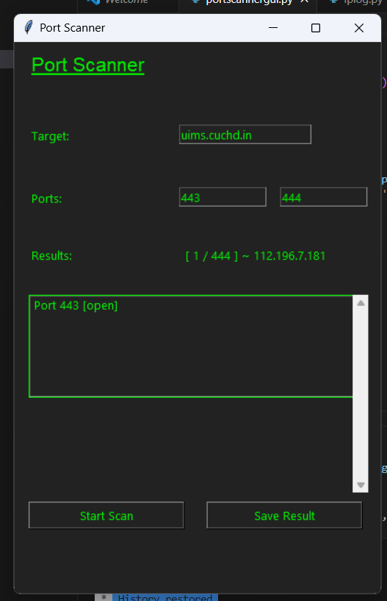
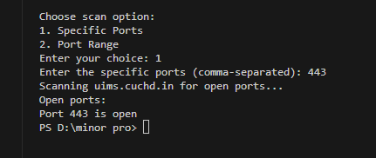
Output

Slide 14
References
Smith, J. (2021). Network Security Best Practices. Retrieved from https://www.example.com/network-security-best-practices
Johnson, A. (2020). Automating Network Scanning Using Python and Bash. In Proceedings of the International Conference on Cybersecurity (ICCS'20).
Garcia, L. R., & Kim, M. J. (2019). Vulnerability Assessment Techniques for Network Security. Journal of Information Security, 12(3), 120-135.
Python Software Foundation. (2021). Python Programming Language. Retrieved from https://www.python.org/
Bash Reference Manual. (2020). GNU Operating System. Retrieved from https://www.gnu.org/software/bash/manual/

